Slide 1
Overview of Supervised Learning
2021.01.04
Young-In Kwon

Slide 2
Context
1. Introduction
2. Variable Types and Terminology
3. Two Simple Approaches to Prediction
4. Statistical Decision Theory
5. Local Methods in High Dimensions
6. Statistical Models, Supervised Learning and Function Approximation
7. Structured Regression Models
8. Classes of Restricted Estimator

Slide 3
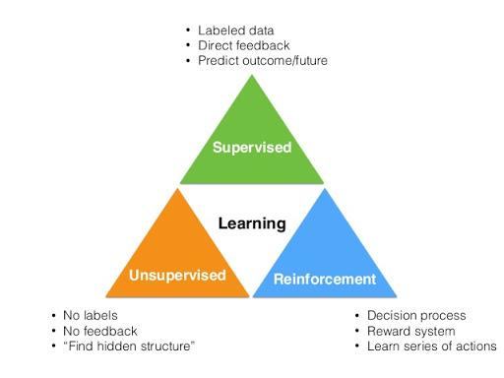
1. Introduction
Notes:
what is supervised learning?
As i hope, you guys know about it already. There are three types of learning mechanism in ML
These are Supervised Learning, Unsupervised Learning, and Reinforcement Learning.
One of them is Supervised Learning that there has actual result value for prediction to minimize error between real value and predicted value. And it’s our topic of this chapter.

Slide 4
2. Variable Types and Terminology
Type of Variables
Qualitative Variable
Quantitative Variable
Notes:
In ML process, there are datas what we handle. target value what we said before is also data.
data seems like ‘Matrix’ what has row and column. row is individual point of data and column is variable what we will talk about. data type is defined per column(variable). what types of data are they?
There are two type of variable
Qualitative variable
Qualitative variable is no sequence each other and used like ‘class’. it says ‘categorical’ or ‘discrete’. sometimes qualitative variable represent to ‘dummy variable’ shape what spreads those column-wisely using binary value. But if it has order between class it’s called Ordered Categorical variable compared with previous non-order categorical variable. I think we couldn’t use dummy method cuz It would lose information about seqeunce.
Quantitative variable
Quantitative variable has discrete and continuous value what doesn’t seem like simple class(Qualitative variable).

Slide 5
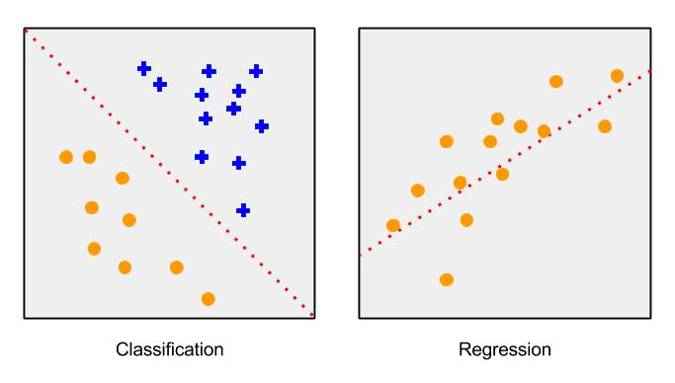
2. Variable Types and Terminology
Problem Definition by data type
Notes:
In supervised learning what I said before, there are two problem definition.
There are Classification and Regression problem by dividing output variable data type
Classification has ‘Qualitative target variable’
Regression has ‘Quantitative target variable’
But whether there is classification or regression problem, we could take similar approach via ‘function approximation’. so huge difference is not occurred by problem definition.

Slide 6
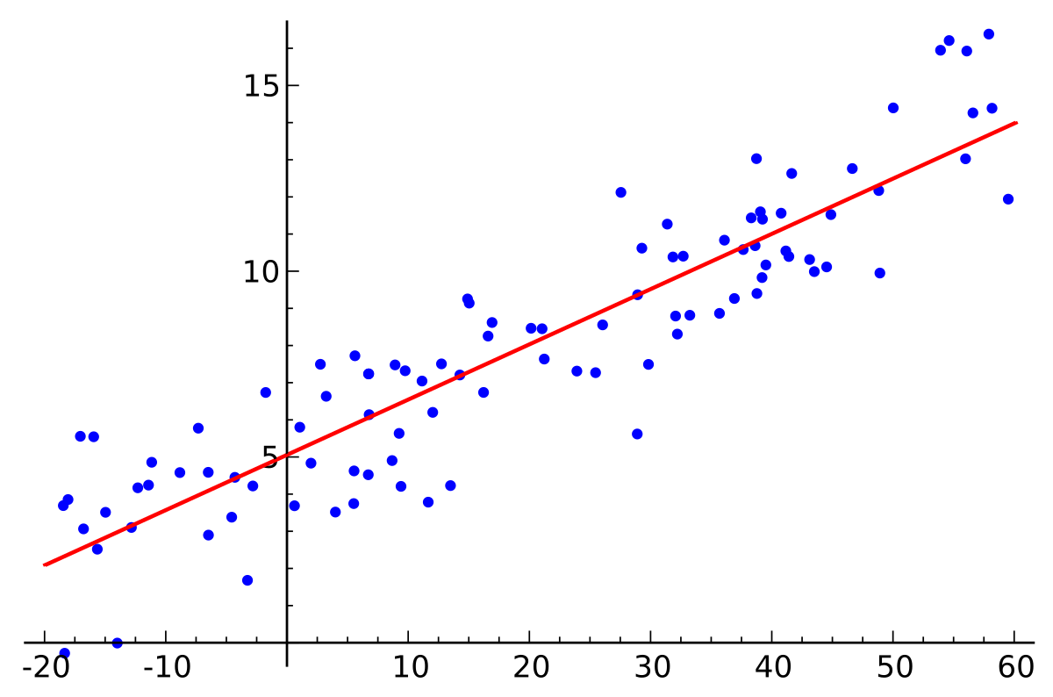

3. Two Simple Approaches to Prediction
linear model and least squares
Notes:
linear model is drawing regression line to the most representatively through data. and it seems linear equation with sum of one intercept and many feature with weight. so it could represent equation 2.1 and if we thought them as matrix, intercept could represent intercept multiply with identity matrix like equation 2.2. and we call them betas after now
what is the objective of linear regression? it is to find adequate intercept and weights(betas) for drawing optimal regression line on dataset. and how to find them?
There are many methods to find, however, We could use Residual Sum of Square(RSS) method for it

Slide 7
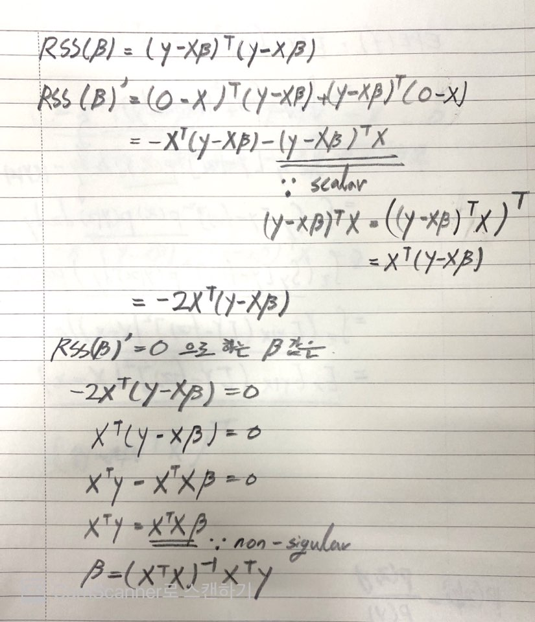

3. Two Simple Approaches to Prediction
linear model and least squares
Notes:
There are many methods to find, however, We could use Residual Sum of Square(RSS) method for it.
equation 2.3 is RSS fomula to find optimal regression line. yi is actual value of data xi transpose beta is prediction value of data.
RSS could think find beta by reducing error between them.
we want to find optimal beta value in RSS equation. so we could think equation 2.3 as polynomial equation of beta.
and equation 2.3. can be represented by 2.4. as matrix, thus if we do partial derivative by beta of eq 2.4., equation -2X transpose (y-X beta)is derived.
partial derivatve by beta

Slide 8
3. Two Simple Approaches to Prediction
k-nearest neighbor

Slide 9
3. Two Simple Approaches to Prediction
comparison

Slide 10
4. Statistical Decision Theory
Expected Prediction Error(EPE)

Slide 11
4. Statistical Decision Theory
NN Prediction

Slide 12
4. Statistical Decision Theory
Categorical Variable

Slide 13
5. Local Methods in High Dimensions
Curse of Dimensionality

Slide 14
5. Local Methods in High Dimensions
1.

Slide 15
5. Local Methods in High Dimensions
2.

Slide 16
5. Local Methods in High Dimensions
sampling density

Slide 17
6. Statistical Models, Supervised Learning and Function Approximation
Statistical Model from the Joint Distribution

Slide 18
6. Statistical Models, Supervised Learning and Function Approximation
Supervised Learning

Slide 19
6. Statistical Models, Supervised Learning and Function Approximation
Function Approximation

Slide 20
7. Structured Regression Models

Slide 21
8. Classes of Restricted Estimator
Roughness Penalty and Bayesian Methods

Slide 22
8. Classes of Restricted Estimator
Kernel Methods and Local Regression

Slide 23
8. Classes of Restricted Estimator
Basis Functions and Dictionary Methods

Slide 24
9. Model Selection and Bias-Variance Trade off

